Slide 1


DAT320:
Merge Replication in SQL Server 2000: Top 10 How To’s
Bren Newman
Program Manager
Microsoft SQL Server Development
Notes:
TechEd 2002

Slide 2

Merge Replication Primer
Replication technology designed for mobile offline/online scenarios
Robust conflict detection and handling
Allows for advanced data filtering to each subscriber
Row or column level change tracking
Final state of data is replicated not intermediate states
Auto generated triggers track changes
Notes:
TechEd 2002

Slide 3
Common deployments
Sales force applications
Field force automation
Server to server with conflicts
Pocket PC platform
Geographically dispersed data synchronization
Notes:
TechEd 2002

Slide 4
demo
Merge Replication in Action
Notes:
TechEd 2002

Slide 5
The Top 10 How To’s
Notes:
TechEd 2002

Slide 6
#10 Security in Merge
Publication Access List
  All Merge agents logins in PAL
Snapshot Share
  Writeable to the snapshot agent
  Needs to be readable by the merge agent account
SP3 introduced role based security
  Users in role are = users in PAL
Notes:
TechEd 2002

Slide 7
#9 Implications of Data Convergence
Convergence = data consistency
Focus on convergence
  Data could not be uploaded from subscriber
    Data is removed from subscriber and placed in conflict tables
  Data could not be downloaded subscriber
    Data is removed from the publisher and placed in conflict tables
  Data moves from one user to another
    Data is removed from one subscription and added to another
Notes:
TechEd 2002

Slide 8
#9 Implications of data convergence
Common problems are related to
  Not for replication (NFR) property not set on constraints (e.g. foreign key relationships)
  Identity range management not configured on identity columns
    Use of smallint, int and bigint
Notes:
TechEd 2002

Slide 9
#8 What are all the settings on the agent for?
Most parameters have very subtle difference
Common parameter combinations have been grouped into profiles
  Server to Server
  Slow Link
  Validation
  Verbose
Notes:
TechEd 2002

Slide 10

demo
Selecting a profile
Notes:
TechEd 2002

Slide 11
#7 Change the schema
SQL 2000 supports the adding and dropping of columns – via stored procs
  sp_repladdcolumn
  sp_repldropcolumn
sp_addmergearticle adds incremental article
  But, requires re-init if publication is filtered
sp_addscriptexec executes admin defined script on subscribers
Notes:
TechEd 2002

Slide 12
demo
Add/drop columns and sp_addscriptexec
Notes:
TechEd 2002

Slide 13

#6 Replicating over an unreliable network
Improve network conditions when possible
Increase the value of TcpMaxDataRetransmissions
Decrease the number of Src & Dest Threads (reduce parallelism)
Put continuous agents in a job loop (i.e. step 3 returns to step 1)
More Info available in appendix
Notes:
TechEd 2002

Slide 14
#6 Replicating over an unreliable network
Improve recoverability by reducing generations per batch
Call sp_MSmakegeneration and sp_MSchunkgeneration on large batches of changes
Notes:
TechEd 2002

Slide 15
#5 Controlling metadata growth
Metadata determines
  What changes have been made since last synchronization
  Do two changes conflict?
  How to resolve conflicts?
Metadata is created when
  User modifies a published table
    Corresponding rowguid entry
      MSmerge_contents – inserts & updates
      MSmerge_tombstone – deletes
      MSmerge_history – history tracking
Notes:
TechEd 2002

Slide 16
#5 Controlling metadata growth
Retention period tells replication
  How long to store metadata
  Maximum time a subscriber can be active without synchronizing with publisher
    If exceeded, user needs to re-initialize
SQL 2000 >= SP1
  Determines whether a cleanup is required and if necessary executes cleanup
  Subscribers must synchronize within retention period
Notes:
TechEd 2002

Slide 17
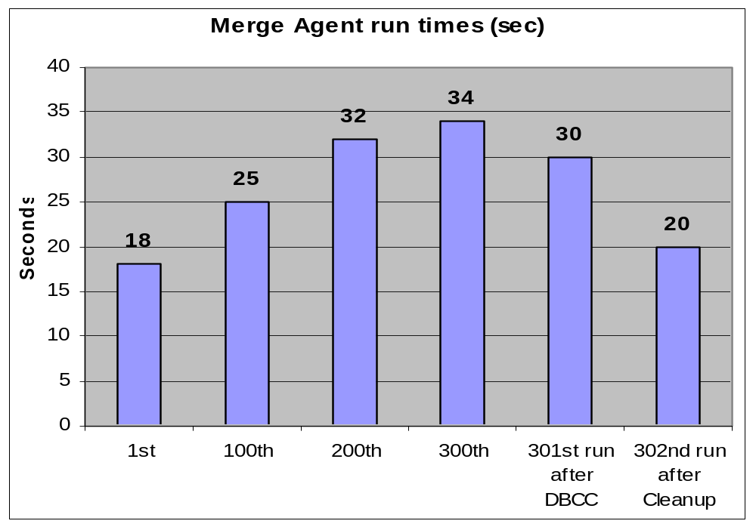
#5 Controlling metadata growth
Why clean up merge metadata
  Affects merge performance (i.e. synchronization times) and disk space usage
  Can periodically run DBREINDEX/INDEXDEFRAG on meta-data
Example:
100 merge subscribers
10 share same partition
30,000 merges (100 * 300)
3,000,000 data changes (100 * 100 * 300)
16,000 conflicts (0.5%)
Notes:
TechEd 2002

Slide 18
#4 Can I sync with a Pocket PC?
SQL Server CE uses Merge Replication to synchronize between device and SQL Server
  Create publication allowing subscription to “Devices running SQL Server CE”
Applications written using VS.NET or eMbedded Visual Tools
IIS sends changes (file-based) between publisher and subscriber
Notes:
TechEd 2002

Slide 19

#4 Can I sync with a Pocket PC?
Daily partitioned merge download
Driver allocated assignments
Changes merged
Merge when cradled
Delivers
shipments
Receives change notifications & new instructions
Capture
delivery details
Delivers
shipments
Customer: Large USA shipping company
Notes:
TechEd 2002

Slide 20
#3 How to setup dynamic filtering
All SQL Server replication technologies allow for static data filtering
Merge allows filtering on a per user or partition basis (called dynamic filtering)
Uses built in functions
  SUSER_SNAME()
  HOST_NAME()
Notes:
TechEd 2002

Slide 21
#3 How to setup dynamic filtering
Ways to optimize dynamic filtering:
  Avoid complex filter clauses
  Avoid complex multi-leveled joins
  Avoid complex UDF’s
  Ensure filter columns are indexed
  Validate use of @join_unique_key = true/false
  Track duration of sp_MSsetupbelongs and sp_MSmakegeneration
Notes:
TechEd 2002

Slide 22
demo
Setup a filtered publication & subscription
Notes:
TechEd 2002

Slide 23
#2 I am having an identity crisis
☺
Notes:
TechEd 2002

Slide 24
demo
Using identities
Notes:
TechEd 2002

Slide 25

#2 Replicating identities across subscribers
What is NFR (Not For Replication)?
  Bypass for replication agents on constraints
Identities need to marked as NFR
  < ID int not null primary key not for replication >
Risk of running out of range
  Increase pool size for Publisher and Subscriber
Threshold
  When should replica request a new range
  Ensure subscriber pool is large enough for autonomy required
Notes:
TechEd 2002

Slide 26
#1 Why is my Merge Slow
Did you set the @run_much_faster = True ☺
There is no silver bullet for performance and scalability
Think “Merge” during db design phase
Most common issues are…
Notes:
TechEd 2002

Slide 27
#1 Why is my Merge Slow
Use the appropriate replication technology
Filtering
  Avoid complex join filter or subset filter statements
  Index columns involved in filters
  Set the join unique key property = true when joining between PK-FK
Decrease retention period when possible
Defragment system table and user table indexes
Notes:
TechEd 2002

Slide 28
#1 Why is my Merge Slow
Split large batches of changes by calling sp_MSmakegeneration
Keep_partition_changes=True
  Avoids sending deletes to all subscribers on partition changes
Apply SP3!
  Several performance and scalability enhancements!!
Notes:
TechEd 2002

Slide 29

Wildcard: How do I program to the Merge COM object?
Use the Replication Active X control
  Merge, Snapshot and Distribution agents
  Any COM evocable development language
    Commonly Visual Basic and C++/C# etc.
Integration with Windows Synchronization Manager
  Task Bar: Programs -> Accessories -> Synchronize
  Internet Explorer: Tools -> Synchronize
Notes:
TechEd 2002

Slide 30
Wildcard: How do I program to the Merge COM object?
Include Reference into development project
  Microsoft SQL Merge Control 8.0
Set Properties
  Publisher, Subscriber, Publication, PublisherLogin, QueryTimeout…
Execute Methods
  Initialize, Run, Terminate, AddSubscription, ReinitializeSubscription…
Eg. Setting Properties & Calling Methods (Visual Basic)
' Set some properties
SQLMerge.Publisher = “NEWMAN_SERVER”
SQLMerge.Publication = "MERGEDB_PUB"
SQLMerge.Subscriber = “SUBSCRIBER_NOTEBOOK”
SQLMerge.SubscriberDatabase = “MERGEDB_SUB"
' Run Methods
SQLMerge.Initialize
SQLMerge.Run
SQLMerge.Terminate
Notes:
TechEd 2002

Slide 31
Additional Information
On http://www.microsoft.com/
  Diagnosing and Troubleshooting Slow Partitioned Merge Processes on …sql/techinfo/development/2000/slowpartitionedmerge.asp
  Merge Performance and Tuning on …/technet/prodtechnol/sql/maintain/Optimize/mergperf.asp
Notes:
TechEd 2002

Slide 32
Appendix…
General Network Error:
TcpMaxDataRetransmissions
Key: Tcpip\Parameters
Value Type: REG_DWORD - Number
Valid Range: 0 - 0xFFFFFFFF
Default: 5 increase to 7 or 8
Notes:
TechEd 2002

Slide 33
Ask The Experts
Get Your Questions Answered
I will be available in the ATE area after this session
Notes:
TechEd 2002

Slide 34
Community Resources
Community Resources
  http://www.microsoft.com/communities/default.mspx
Most Valuable Professional (MVP)
  http://www.mvp.support.microsoft.com/
Newsgroups
  Converse online with Microsoft Newsgroups, including Worldwide
  http://www.microsoft.com/communities/newsgroups/default.mspx
User Groups
  Meet and learn with your peers
  http://www.microsoft.com/communities/usergroups/default.mspx
Notes:
TechEd 2002

Slide 35

evaluations
Notes:
TechEd 2002

Slide 36

© 2003 Microsoft Corporation. All rights reserved.
This presentation is for informational purposes only. MICROSOFT MAKES NO WARRANTIES, EXPRESS OR IMPLIED, IN THIS SUMMARY.
Notes:
TechEd 2002

